Slide 1
Journey PPT
Shell Training
Week 5 – 18/9/2023 to 22/9/2023
Daksh Malik
Associate Data Engineer

Slide 2


Day 1 -
Doubt Solving session
Repitation of Azure Data Factory
Hands-on on Azure Data Factory
loading the dataset into the storage account
Creation of pipeline
Fetching, updating rows of a table and getting affected in ADF and data storage
Creating the dataflow and CDC for the instances

Slide 3
Day 2 -
Azure Synapse Analytics
Introduction to Azure Synapse Analytics
Mapping of data flow
Creation of pipeline, Data Ingestion and Preparation
Write and execute SQL queries
Understanding query performance optimization technique
Exploring more options like manage, linked device creation
Explanation with theory and practical for all of the above concepts.

Slide 4
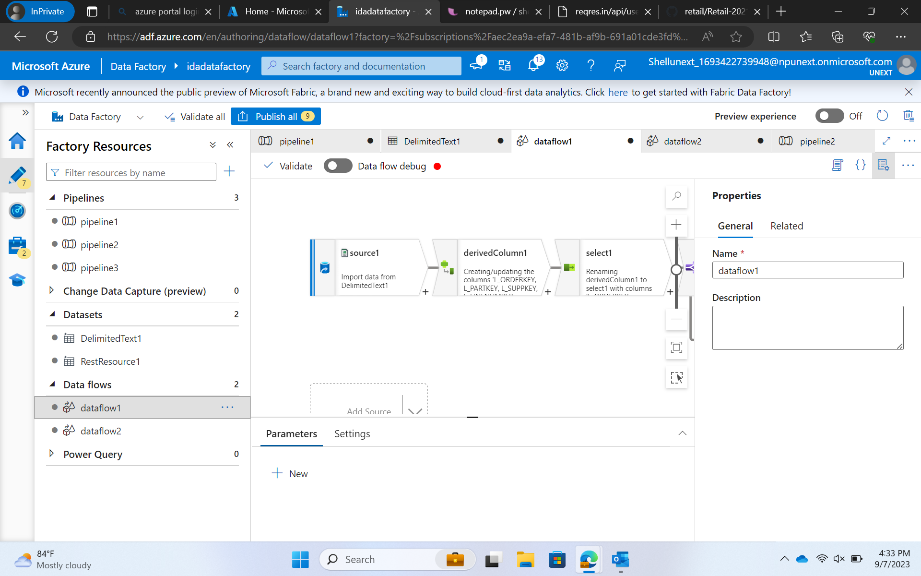

Slide 5
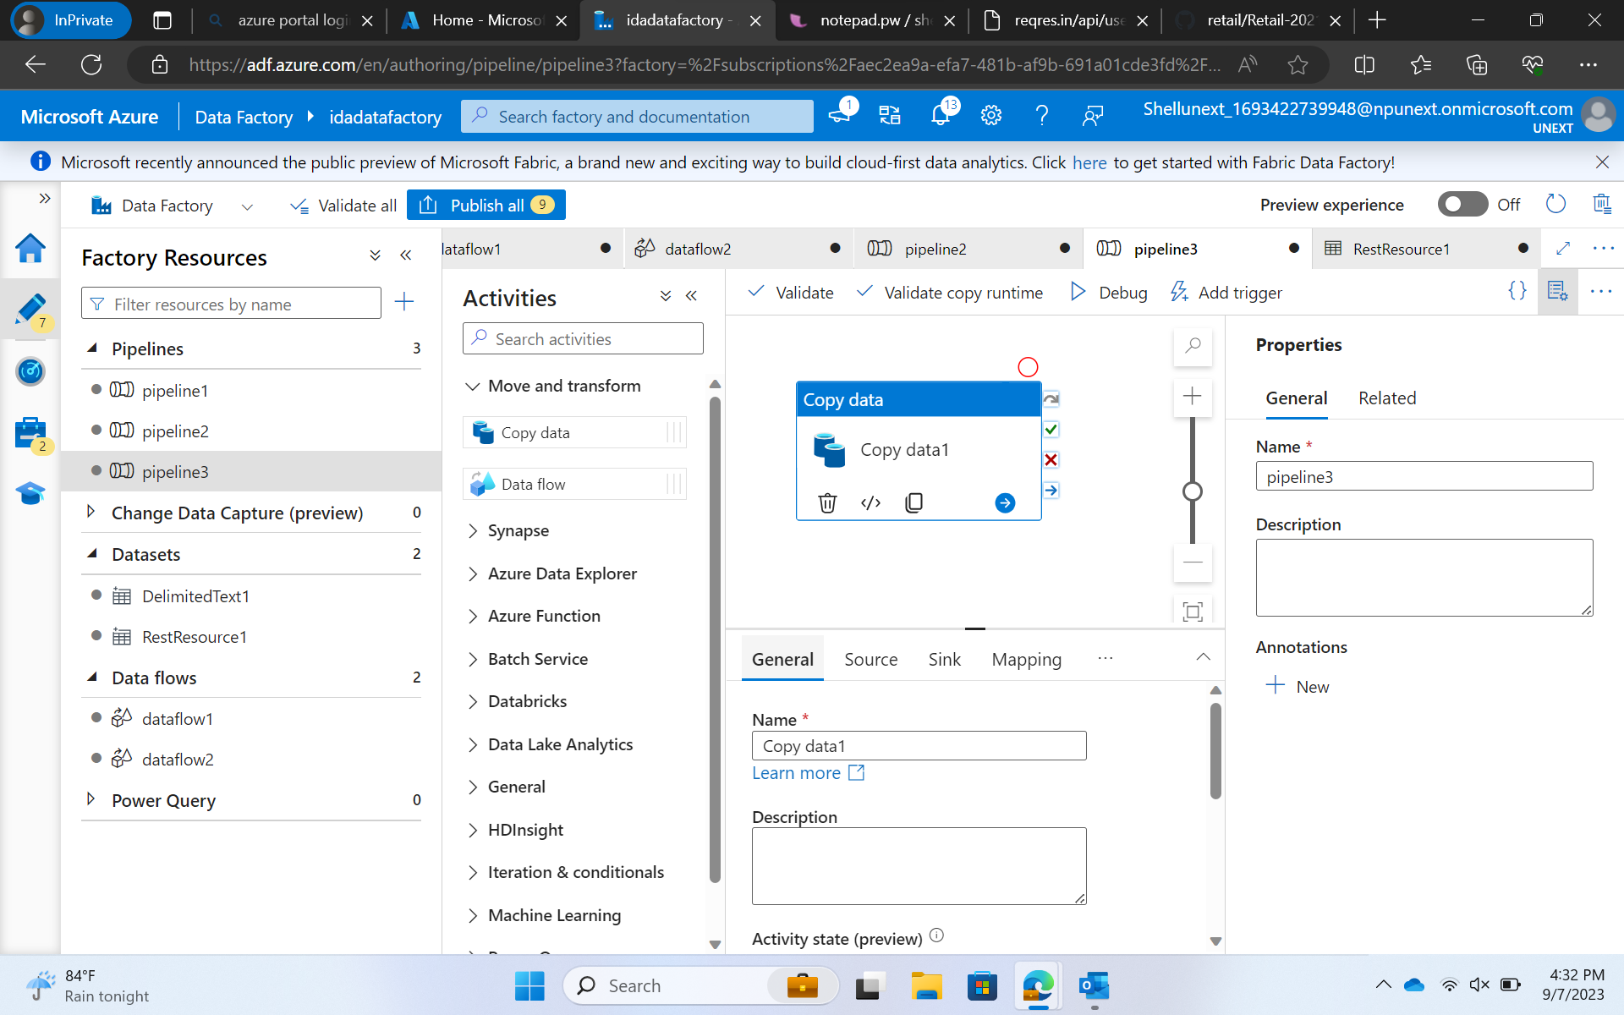

Slide 6
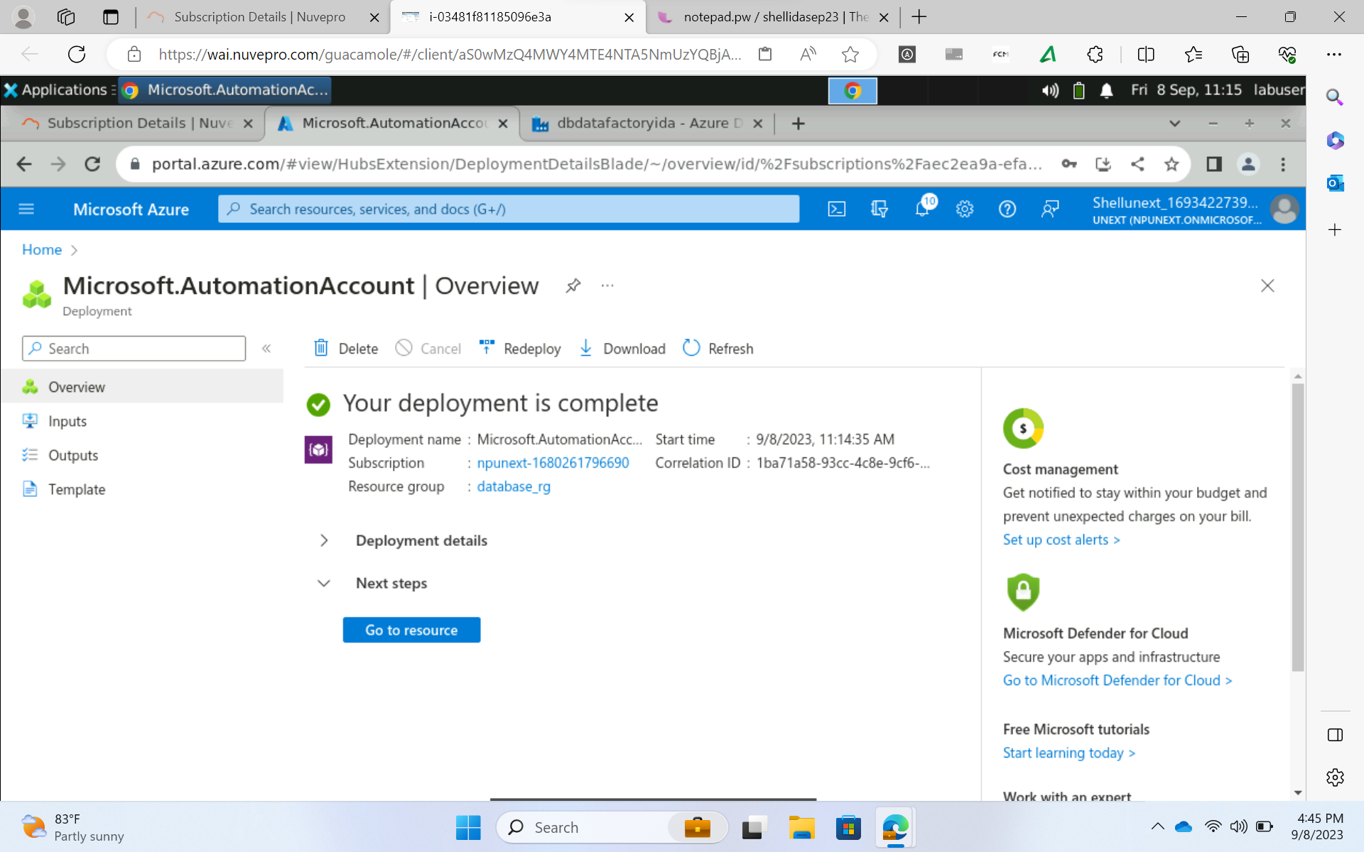

Slide 7
Day 3 -
Data Visualization using Power-Bi
Understanding and exploring about Power-Bi
Connecting to the various sources
Data load and transformation- removing duplicates, adding column, slicers, and group
Introduction to Dax and calculated column
Implicit and explicit measures
Row-level security and aggregation function

Slide 8
Day 4 -
Understanding various chart-type
Report and models
Dashboard
Hands-on
Recap
Scenario-based chart preparation

Slide 9
Day 5 -
Introduction to Python
Variables, data types
Features of python
Creating a small data set
Exploring functions like zip, enumerate
Working on Lists, Dictionary, for-loop

Slide 10
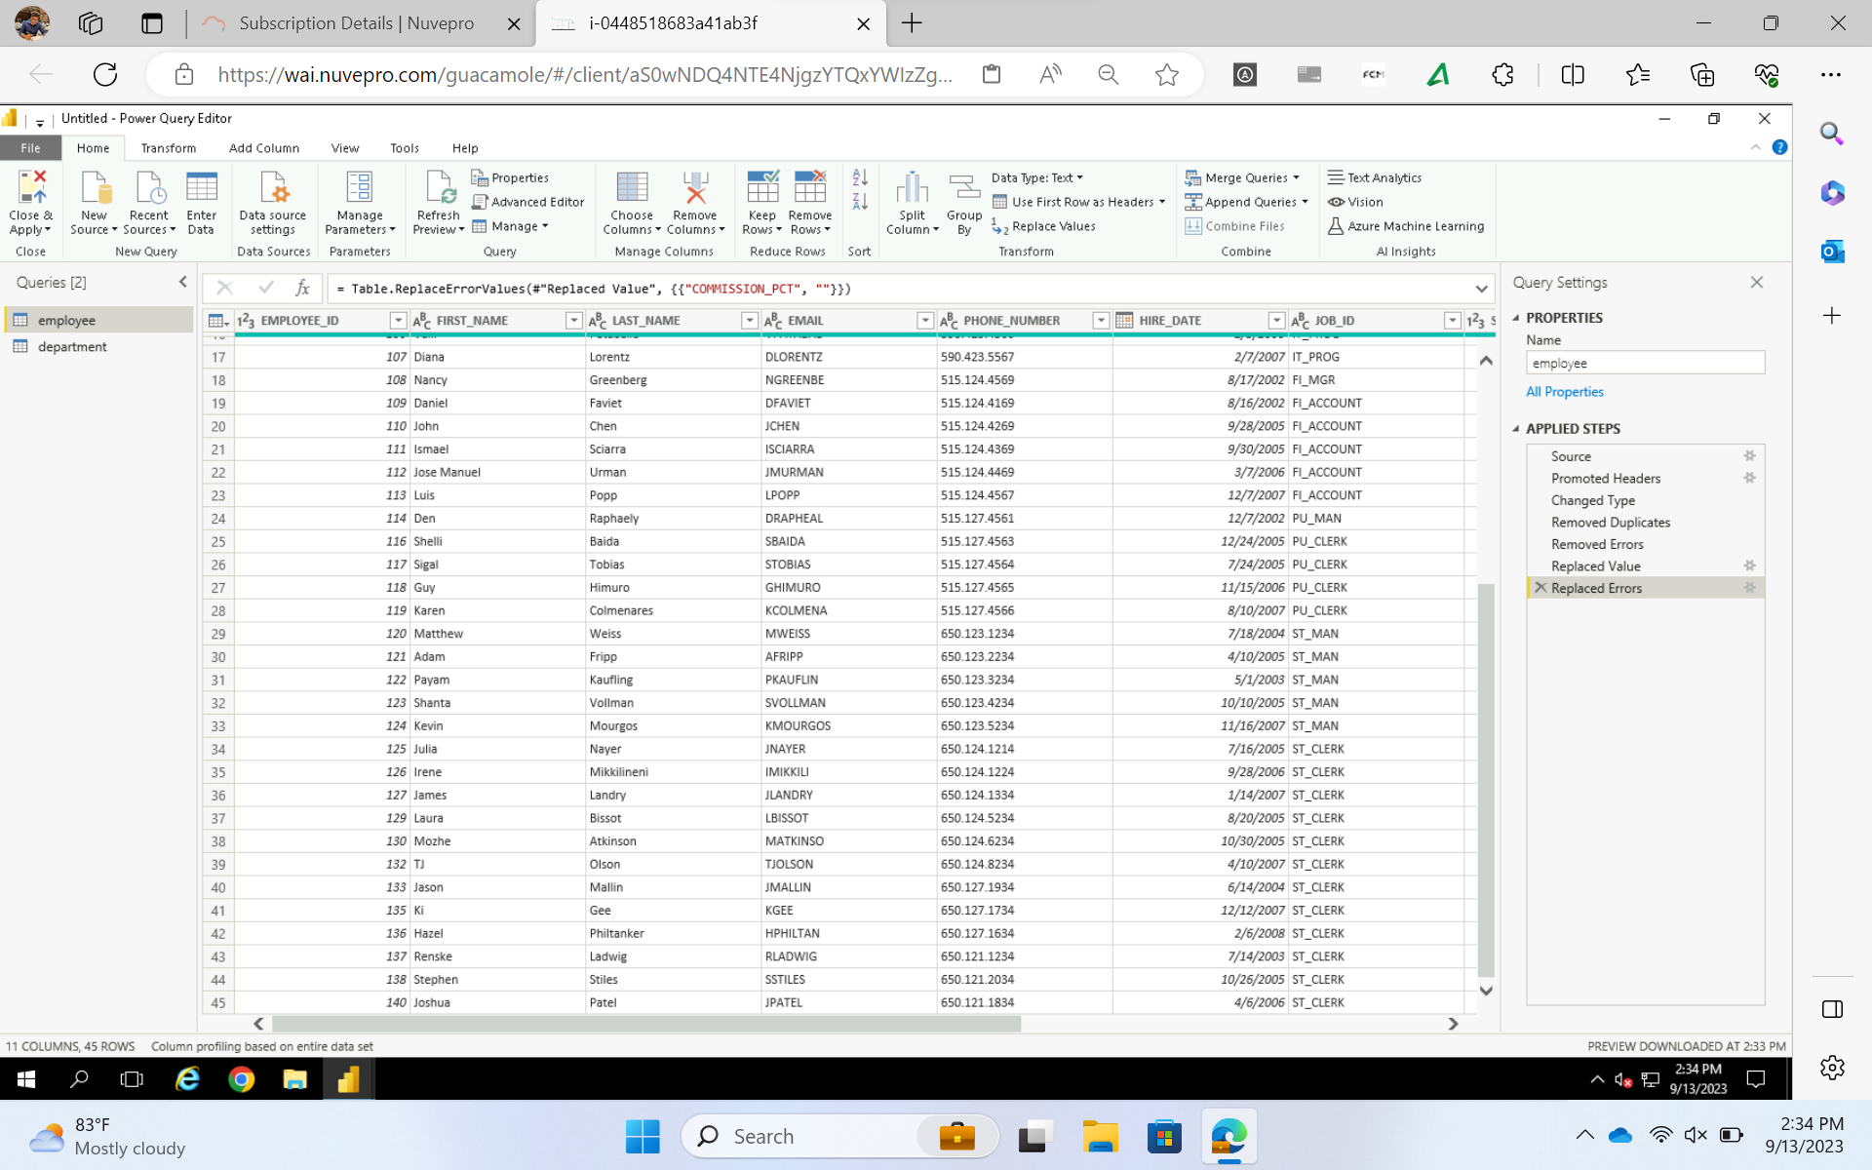

Slide 11
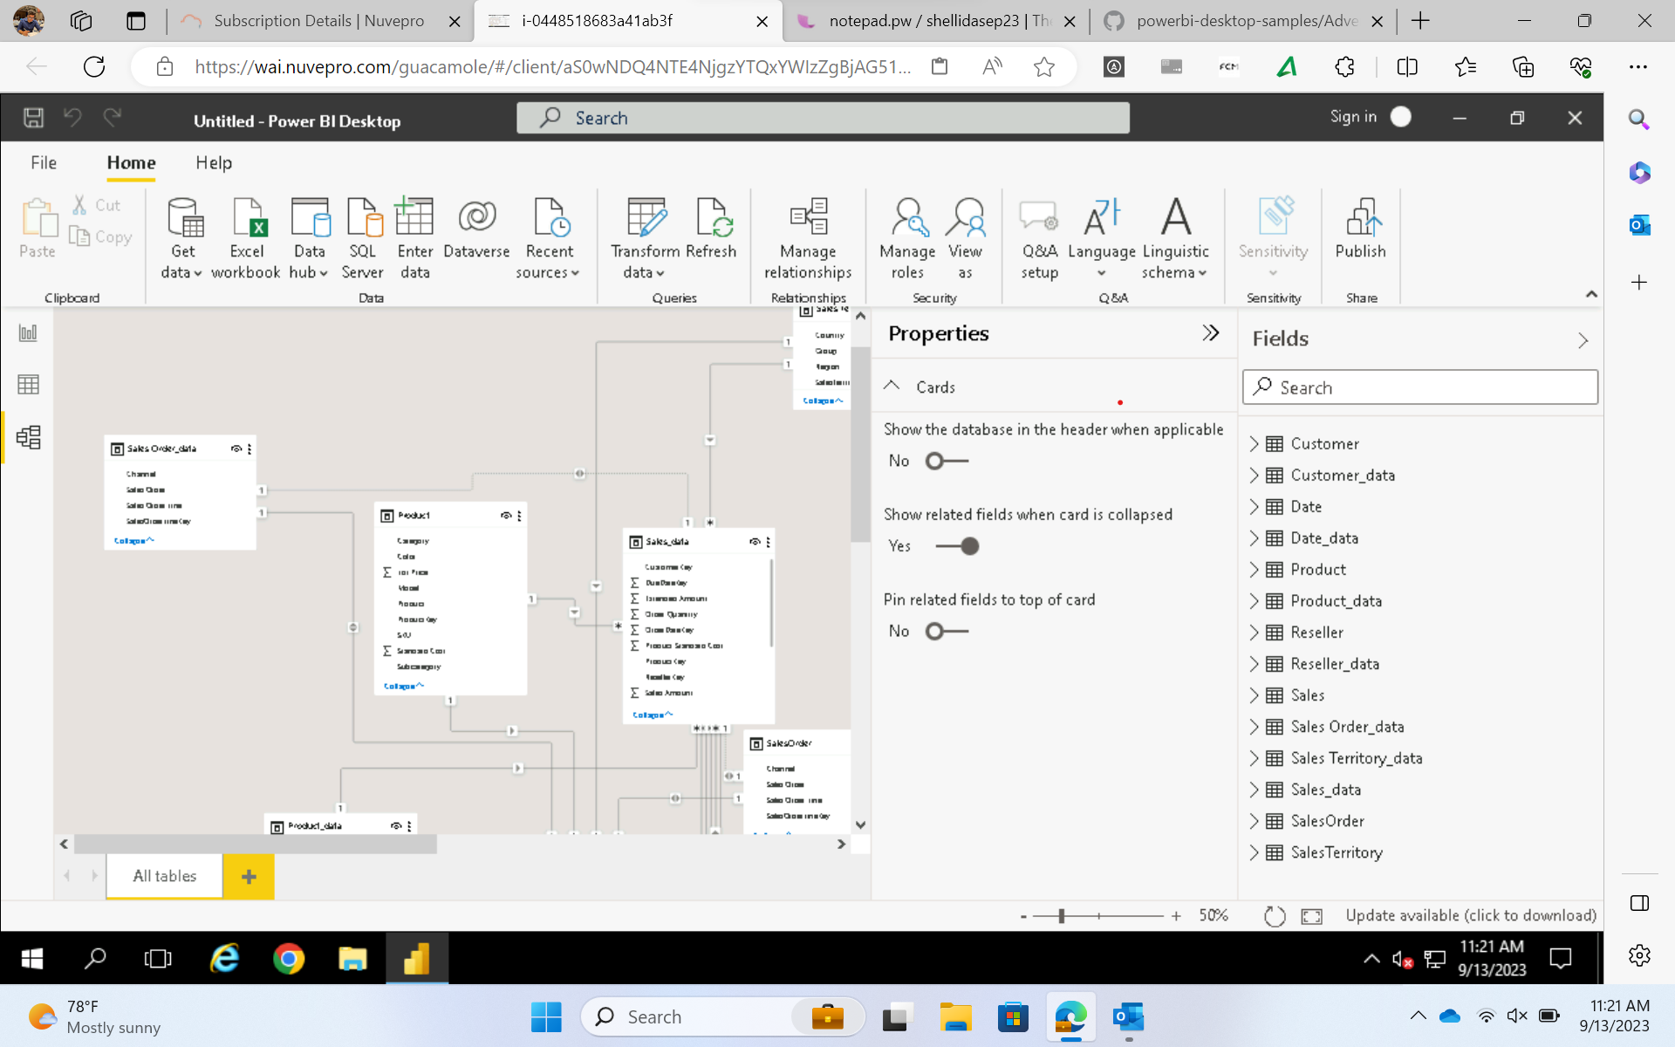

Slide 12
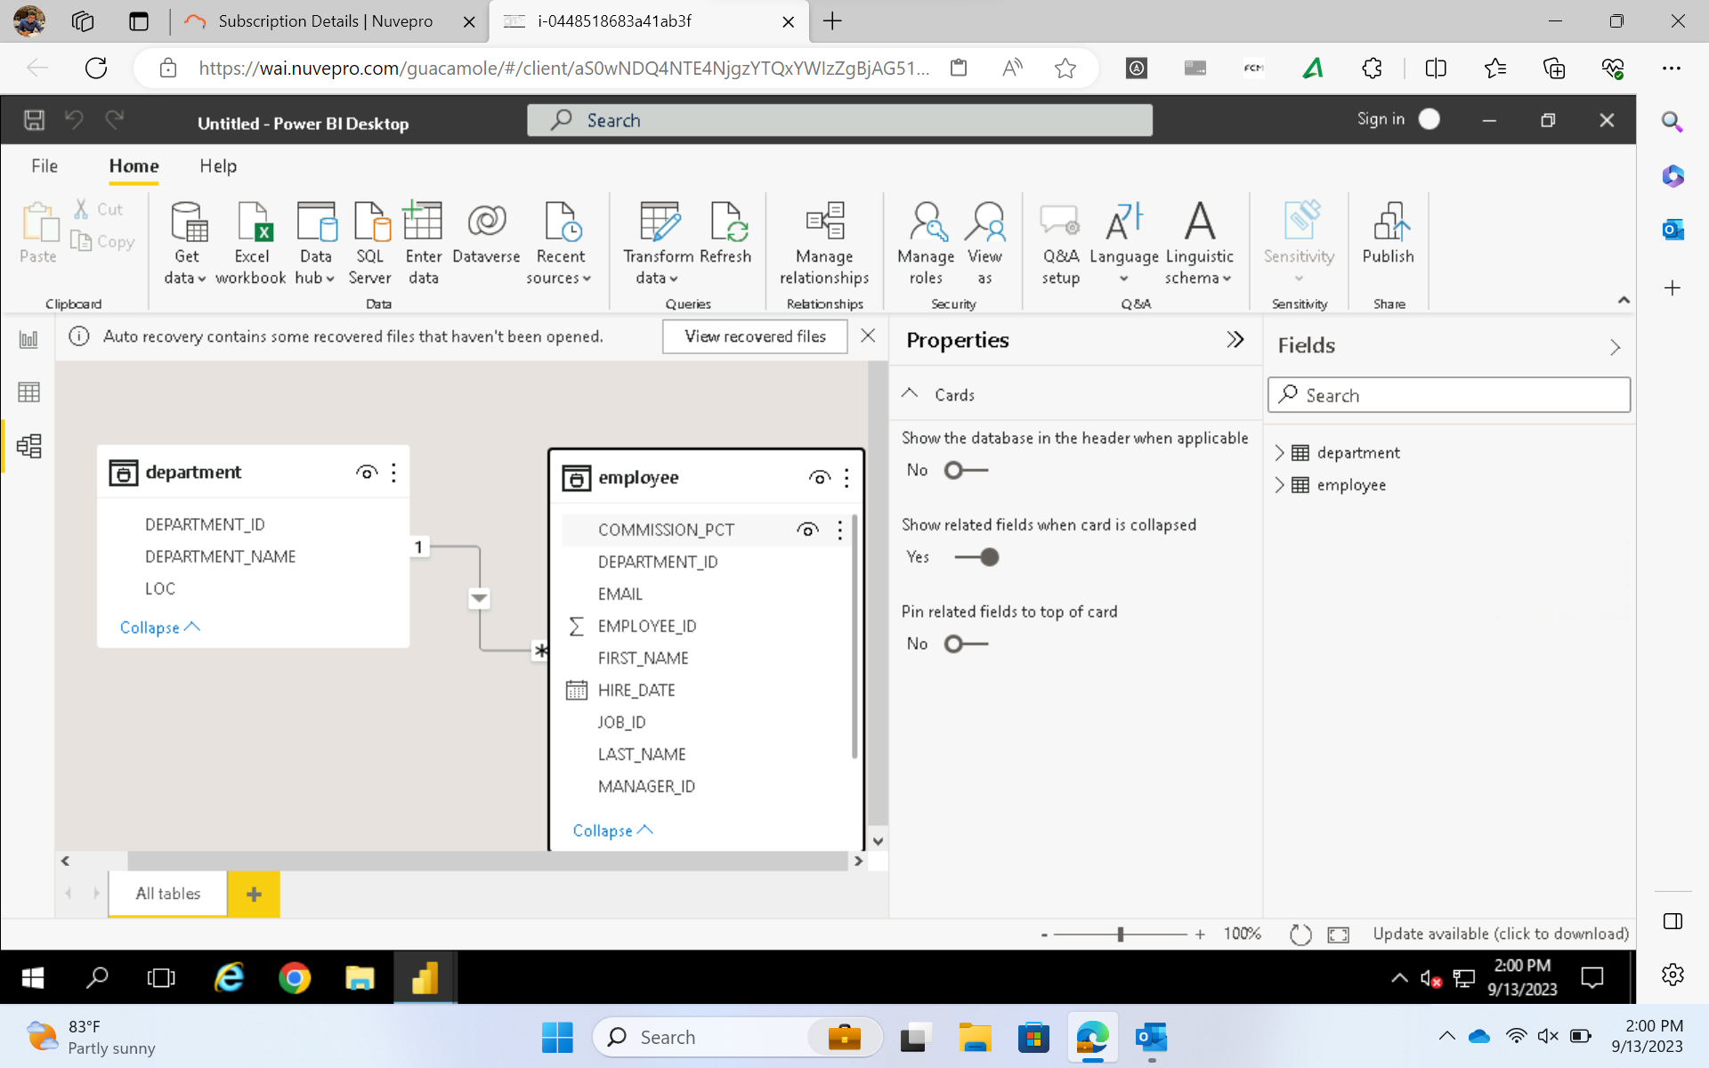

Slide 13
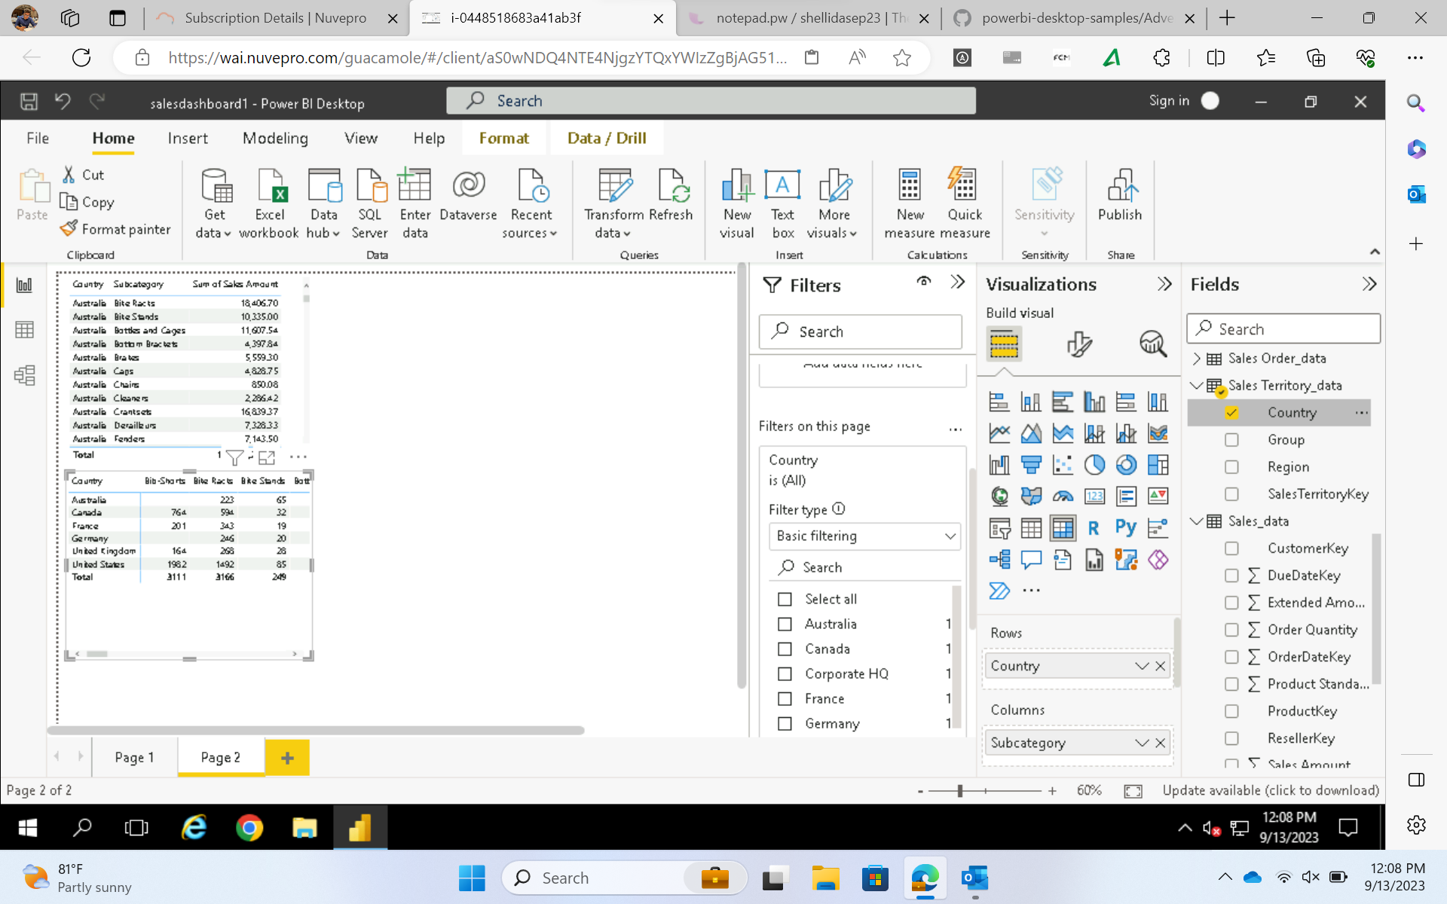

Slide 14
Thank you for your time.

